Slide 1
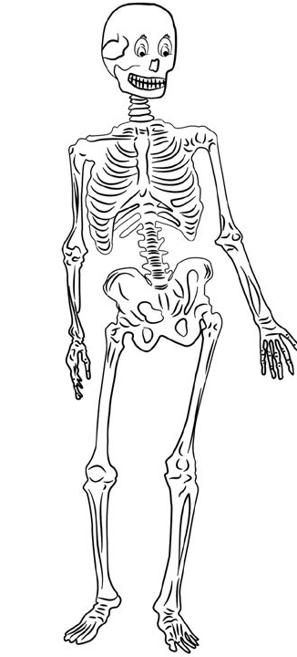
Skeletal System
Learning Objective:
To know the different classifications of bones in the body.
To know the six types of joints in the body and understand how they effect movement.

Slide 2
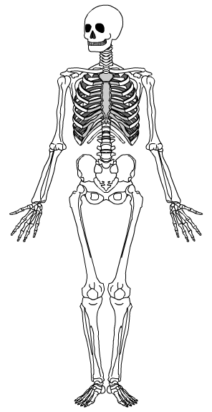
Starter
Complete skeletal system recap sheet
How many bones can you remember?
Learning Objective:
To know the different classifications of bones in the body.
To know the six types of joints in the body and understand how they effect movement.

Slide 3
Recap
Skeletal System Cowboys
Learning Objective:
To know the different classifications of bones in the body.
To know the six types of joints in the body and understand how they effect movement.

Slide 4
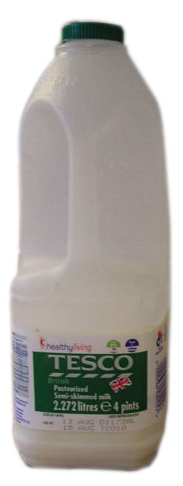
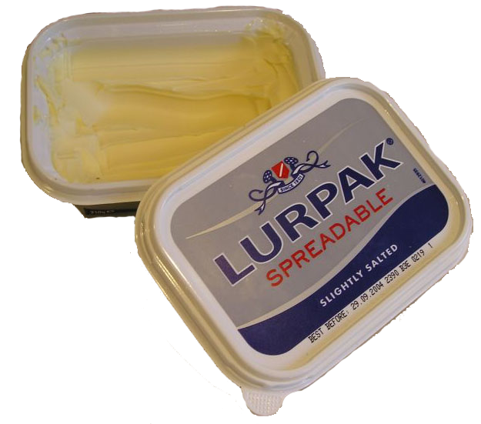
Diet and exercise for healthy bones
Bones are alive. Old cells and bone tissue are constantly being broken down and replaced by new ones.
Certain substances are needed for this process of growth and renewal. These need to be include in your diet.
Minerals are important. They are inorganic substances which perform a variety of functions in the body.
Calcium is the most important for bone strength. It is found in cereals, milk and other dairy products. Some fish and vegetables also contain calcium.
Learning Objective:
To know the different classifications of bones in the body.
To know the six types of joints in the body and understand how they effect movement.
Notes:
Osteoblasts - are bone cells that make new bone.
Osteoclasts – are bone cells that break bone down.

Slide 5
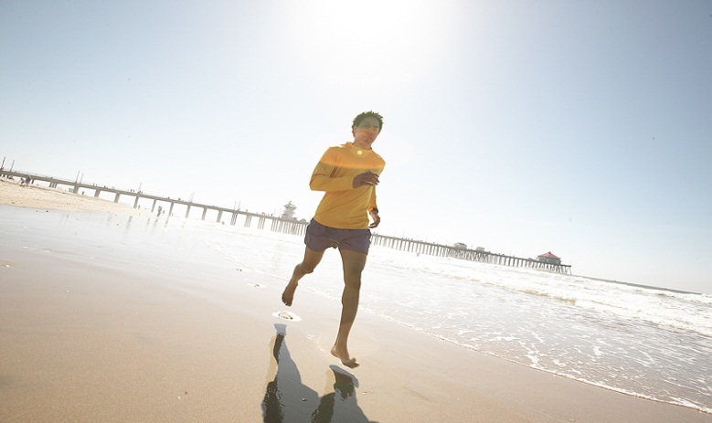
Diet and exercise for healthy bones
After the age of 35, bone tissue begins to be broken down more quickly than it is replaced.
This means that bone density and strength begin to deteriorate. Osteoporosis can occur, where bones become very brittle.
As well as a good diet, regular weight-bearing exercise can help to maintain bone density and strength.
Learning Objective:
To know the different classifications of bones in the body.
To know the six types of joints in the body and understand how they effect movement.
Weight-bearing exercise can include walking, jogging and ball or racket games.
Notes:
Exercising makes osteoblasts work harder and will therefore keep bones strong, even though as we age osteoblasts don’t work as hard. That’s why it is important to keep doing weight bearing exercises as we get older.
Losing too much bone density and strength can result in osteoporosis.
Image © 2006 Jupiterimages Corporation

Slide 6
The vertebral column
The spine is also known as the vertebral column.
It is made up of 33 irregularly shaped bones called vertebrae. Between each vertebra there is a pad of cartilage which allows movement and prevents the bones grinding together.
The spine’s inverted ‘s’ shape gives it strength.
The vertebrae protect the spinal cord. This important nerve runs up the spine, through the centre of each vertebra.
The vertebral column is divided into 5 sections.
Learning Objective:
To know the different classifications of bones in the body.
To know the six types of joints in the body and understand how they effect movement.

Slide 7
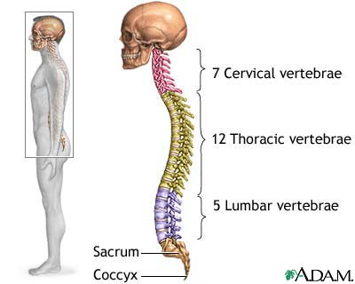
Learning Objective:
To know the different classifications of bones in the body.
To know the six types of joints in the body and understand how they effect movement.

Slide 8
Classification of bones – long bones
Bones are divided into a number of different categories. So far we have mainly dealt with long bones.
Long bones have a long shaft containing yellow bone marrow.
They are responsible for a lot of movement and often act as levers.
Long bones include the femur, humerus, tibia, fibula, the metatarsals, metacarpals and phalanges.
Long bones contain red bone marrow for producing blood cells.
Long bone
Learning Objective:
To know the different classifications of bones in the body.
To know the six types of joints in the body and understand how they effect movement.
Notes:
Discuss with students the sporting functions of long bones.

Slide 9
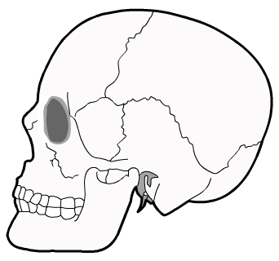
Classification of bones – flat bones
Flat bones perform a variety of functions. These include:
protection for delicate areas, for example, the cranium protects the brain.
areas for muscle attachment, for example, many of the muscles of the lower back and legs attach to the wide flat bone of the pelvis.
Cranium
They are made up of spongy bone between two layers of hard compact bone.
They have a large surface area.
Learning Objective:
To know the different classifications of bones in the body.
To know the six types of joints in the body and understand how they effect movement.
Notes:
Discuss with students the sporting functions of flat bones.

Slide 10
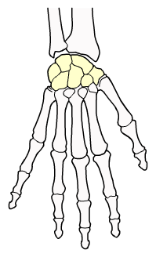
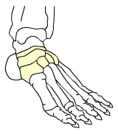
Classification of bones – short bones
Short bones are very light and very strong.
They are small and squat in shape.
They are composed of spongy bone with a thin layer of compact bone on the outside.
The carpals in the wrist and the tarsals in the foot are examples of short bones.
carpals
Learning Objective:
To know the different classifications of bones in the body.
To know the six types of joints in the body and understand how they effect movement.
tarsals
Notes:
Discuss with students the sporting functions of short bones.

Slide 11
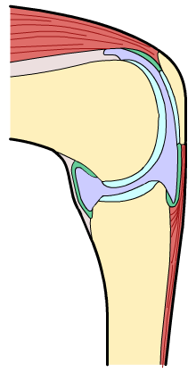
Classification of bones – irregular bones
patella
Irregular bones are specially shaped to perform a particular function.
They are composed of spongy bone on the inside and compact bone on the outside.
Examples include the patella and the vertebrae.
Learning Objective:
To know the different classifications of bones in the body.
To know the six types of joints in the body and understand how they effect movement.
The patella is shaped so that the quadriceps tendon slides easily over the knee joint.
Notes:
Discuss with students the sporting functions of irregular bones.

Slide 12
Synovial Joints
http://www.youtube.com/watch?v=bG1_4emGO9I&feature=related
Your shoulder can move in more directions than your knee. That’s because it’s a different kind of joint.
There are actually six types of synovial joint you need to know about
Learning Objective:
To know the different classifications of bones in the body.
To know the six types of joints in the body and understand how they effect movement.

Slide 13
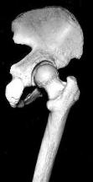
1. Ball and Socket Joints
The most flexible joints and also the strongest.
These allow swing and rotation and are very stable.
The hip and the shoulder are excellent examples. So this allows flexion, extension, adduction, abduction and rotation
Learning Objective:
To know the different classifications of bones in the body.
To know the six types of joints in the body and understand how they effect movement.

Slide 14
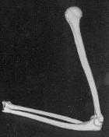
2. Hinge Joints
These are found at the elbow and the knee. They allow movement backwards and forwards
This allows flexion and extension
Learning Objective:
To know the different classifications of bones in the body.
To know the six types of joints in the body and understand how they effect movement.

Slide 15
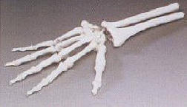
3. Gliding
The bones move a little bit in all directions by sliding over each other.
Like between the tarsals in the foot or carpals in the hand.
Learning Objective:
To know the different classifications of bones in the body.
To know the six types of joints in the body and understand how they effect movement.

Slide 16
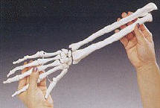
4. Pivot
A joint which allows rotation in the socket. The atlas and axis (first and second vertebrae under the head) allow your head to rotate.
The forearm twists and untwists (flip your hand back and forth) because of a pivot joint between the radius and ulna.
Only allows rotation
Learning Objective:
To know the different classifications of bones in the body.
To know the six types of joints in the body and understand how they effect movement.

Slide 17
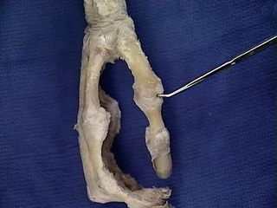
5. Saddle
Like in the thumb
The joint can move forwards and backwards, left to right – but it can’t rotate.
Allows flexion, extension, adduction and abduction
Learning Objective:
To know the different classifications of bones in the body.
To know the six types of joints in the body and understand how they effect movement.

Slide 18
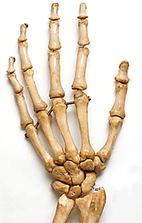
6. Condyloid
Like the wrist.
The joint can move forwards and backwards, left to right – but it can’t rotate.
Allows flexion, extension, adduction and abduction.
Learning Objective:
To know the different classifications of bones in the body.
To know the six types of joints in the body and understand how they effect movement.

Slide 19
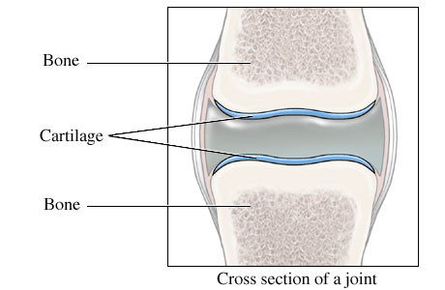
Cartilage
Cushions between bones
Stop rubbing during movement
Acts as a shock absorber
Stabilises joints
Prevents excess movement

Slide 20
Types of joint movement
Extension = Opening a joint
Flexion = Closing a joint
Adduction = Moving towards an imaginary centre line
Abduction = Moving away from an imaginary centre line
Rotation = Turning a limb clockwise or anti-clockwise.
Learning Objective:
To know the different classifications of bones in the body.
To know the six types of joints in the body and understand how they effect movement.

Slide 21
Simon Says….
Worksheet

