Slide 1
The structure of the skeletal system

Slide 2
Functions of the skeleton
The skeleton performs many functions in the body.
1
Shape – The skeleton gives us our shape and determines our size.
2
Support – The skeleton supports muscles and organs.
3
Protection – The skeleton protects delicate parts of the body like the brain and lungs.
4
Movement – The skeleton allows us to move. Muscles are attached to the bones and move them as levers.
5
Blood cell production – blood cells are made in the bone marrow.

Slide 3
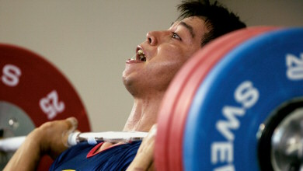
Shape and size
Your skeleton affects your body shape and size.
Bones play an important part in determining your height and build. People with long, light bones are usually tall and thin, whilst people with short, thick bones are likely to be short and more heavily built.
Some sports are more suited to people of a particular size or body shape. This means that your skeleton and bone size can affect your performance in different sports.
For example, weightlifting favours individuals with strong, heavy bones.
Notes:
Link this to work on somatotypes.

Slide 4
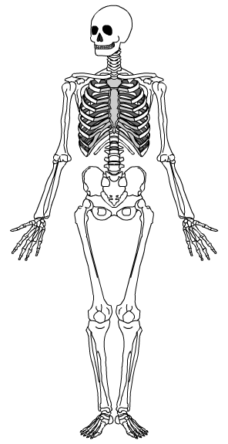
Support
The skeleton acts as a framework.
It gives the body support, enabling us to stand and walk upright.
The bones of the back and chest support internal organs and help to keep them in place.
The bones of the body are held together by ligaments.
The skeleton provides a framework for the muscles, which are attached to bones by tendons.
Can you imagine what humans would look like if they didn’t have bones to support them?

Slide 5
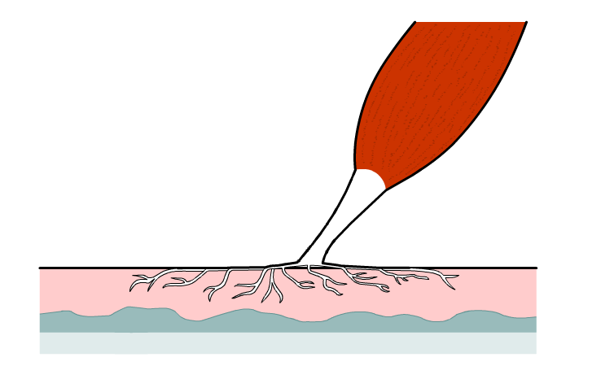
Movement
Bones work with muscles to produce movement.
Muscles are attached to bones by tendons.
Bones have surfaces that allow for strong attachment. Tendons fuse with the tough Periosteum membrane on the outside of the bone.
Muscle
Tendon
Periosteum
Bone

Slide 6
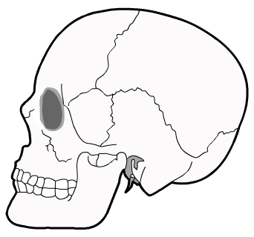
Protection
cranium
Some of our body parts, such as the brain, are very delicate and need protection from external forces.
Bones can protect body parts from impacts and injuries.
The cranium protects the brain. It encloses the brain entirely in a shell of bone.
The rib cage protects the delicate organs of the chest.
Can you think of two reasons why the rib cage has gaps in it rather than being a solid shell of bone?
Notes:
Answers:
The rib cage needs to be flexible enough to allow the movements necessary for breathing.
A solid bone rib cage would be extremely heavy, making movement more difficult.
Could also point out that the organs of the chest are not quite as delicate as the brain, so solid bone protection is less necessary.

Slide 7
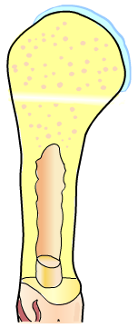
Blood cell production
Red marrow embedded in spongy bone
Red and white blood cells and platelets are made in the bones.
The ends of long bones and some other bones including the ribs, humerus, femur and even vertebrae bones, contain red bone marrow.
This is where the blood cells are produced.
The shaft of long bones is filled with yellow bone marrow which does not produce blood cells.
Yellow bone marrow in the shaft

Slide 8
Naming bones
Cranium (skull)
Clavicle (collar bone)
Jaw bone
Sternum (breast bone)
Ribs
Pelvis
Humerus
Sacrum
Radius
Ulna
Patella (knee cap)
Femur
Tibia
Fibula
Notes:
Encourage students to learn both the common name and scientific name of each bone.

Slide 9
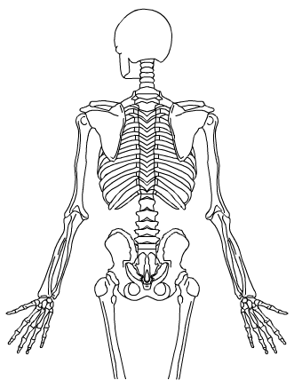
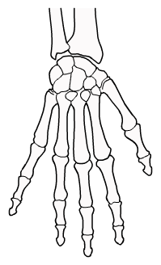
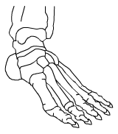
Naming bones
Scapula (shoulder blade)
Vertebral column (spine)
HAND
Carpals
Metacarpals
FOOT
Tarsals
Metatarsals
Phalanges
Notes:
Encourage students to learn both the common name and scientific name of each bone.

Slide 10
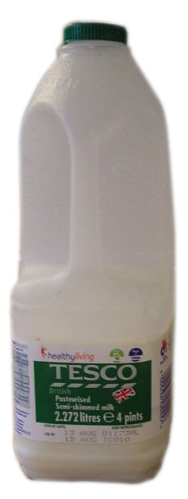
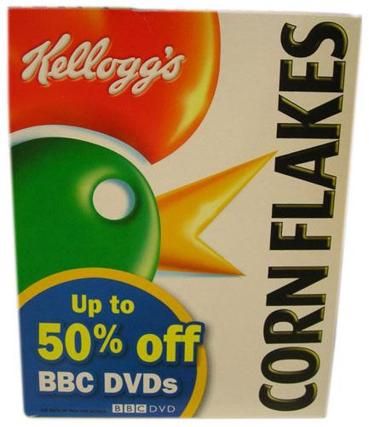
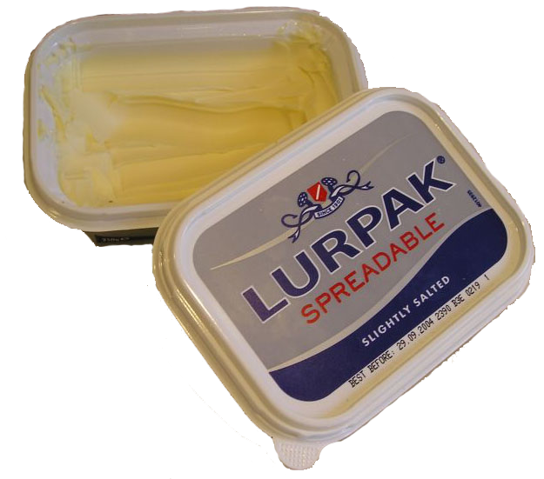
Diet and exercise for healthy bones
Bones are alive. Old cells and bone tissue are constantly being broken down and replaced by new ones.
Certain substances are needed for this process of growth and renewal. These need to be include in your diet.
Minerals are important. They are inorganic substances which perform a variety of functions in the body.
Calcium is the most important for bone strength. It is found in cereals, milk and other dairy products. Some fish and vegetables also contain calcium.
Notes:
Osteoblasts - are bone cells that make new bone.
Osteoclasts – are bone cells that break bone down.

Slide 11
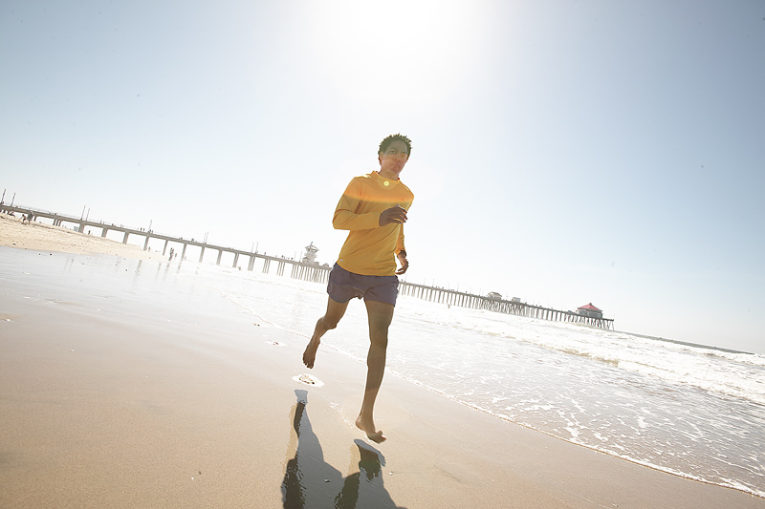
Diet and exercise for healthy bones
After the age of 35, bone tissue begins to be broken down more quickly than it is replaced.
This means that bone density and strength begin to deteriorate. Osteoporosis can occur, where bones become very brittle.
As well as a good diet, regular weight-bearing exercise can help to maintain bone density and strength.
Weight-bearing exercise can include walking, jogging and ball or racket games.
Swimming does not help, as your weight is supported.
Notes:
Exercising makes osteoblasts work harder and will therefore keep bones strong, even though as we age osteoblasts don’t work as hard. That’s why it is important to keep doing weight bearing exercises as we get older.
Losing too much bone density and strength can result in osteoporosis.
Image © 2006 Jupiterimages Corporation

Slide 12
Exam-style questions
Bones perform a number of functions in the body.
Name two functions of the skeleton.
Give an example of a bone which performs each of the functions you listed above.
3. Karim wants to become a professional basketball player.
How may Karim’s skeleton affect his performance?
Suggest two things that Karim could do to make sure that his bones stay healthy as he gets older.
Notes:
Ossification
a) Possible functions: shape, movement, support, protection, blood production. b) Shape – e.g. clavicle gives shape to the shoulder (almost any bone can be used here). Movement – e.g. femur allows movement of the leg. Support – e.g. the ribcage supports internal organs. Protection – e.g. the cranium protects the brain. Blood production – e.g. blood cells are made in the red bone marrow in the humerus (or any other long bone).
a) The skeleton determines many physical attributes, especially height and build. Basketball favours tall performers with light bones. Performers in high intensity sports like basketball require strong bones. b) karim could eat a healthy balanced diet rich in minerals like calcium. He could also make sure that he does regular weight-bearing exercise.

